Slide 1

Ingeniería de soluciones con AI
Docente:
Francisco Macaya
Semestre 2026-1

Slide 2

Claude Code es una herramienta de linea de comandos que convierte a Claude en un agente de coding autonomo. Puede leer y editar archivos, ejecutar comandos, explorar tu codebase completo y completar tareas complejas de principio a fin.
Notas: https://code.claude.com/docs/en/best-practices
Notes:
Model distillation suggests that it’s possible to capture a large model’s behaviors using fewer parameters. Could it be that within the large model, there exists a subset of parameters capable of capturing the entire model’s behavior? This is the core concept behind pruning.
Pruning, in the context of neural networks, has two meanings. One is to remove entire nodes of a neural network, which means changing its architecture and reducing its number of parameters. Another is to find parameters least useful to predictions and set them to zero. In this case, pruning doesn’t reduce the total number of parameters, only the number of non-zero parameters. This makes the model more sparse, which both reduces the model’s storage space and speeds up computation.
Pruned models can be used as-is or be further finetuned to adjust the remaining parameters and restore any performance degradation caused by the pruning process. Pruning can help discover promising model architectures (Liu et al., 2018). These pruned architectures, smaller than the pre-pruned architectures, can also be trained from scratch (Zhu et al., 2017).
In the literature, there have been many encouraging pruning results. For example, Frankle and Carbin (2019) showed that pruning techniques can reduce the non-zero parameter counts of certain trained networks by over 90%, decreasing memory footprints and improving speed without compromising accuracy. However, in practice, as of this writing, pruning is less common. It’s harder to do, as it requires an understanding of the original model’s architecture, and the performance boost it can bring is often much less than that of other approaches. Pruning also results in sparse models, and not all hardware architectures are designed to take advantage of the resulting sparsity.
Weight-only quantization is by far the most popular approach since it’s easy to use, works out of the box for many models, and is extremely effective. Reducing a model’s precision from 32 bits to 16 bits reduces its memory footprint by half. However, we’re close to the limit of quantization—we can’t go lower than 1 bit per value. Distillation is also common because it can result in a smaller model whose behavior is comparative to that of a much larger one for your needs.

Slide 3

Claude Code: “La mejor manera de programar en el mercado”
¿Dónde aprender?
https://www.anthropic.com/
Claude Code es una herramienta de linea de comandos que convierte a Claude en un agente de coding autonomo. Puede leer y editar archivos, ejecutar comandos, explorar tu codebase completo y completar tareas complejas de principio a fin.
Notas: https://code.claude.com/docs/en/best-practices
Notes:
Model distillation suggests that it’s possible to capture a large model’s behaviors using fewer parameters. Could it be that within the large model, there exists a subset of parameters capable of capturing the entire model’s behavior? This is the core concept behind pruning.
Pruning, in the context of neural networks, has two meanings. One is to remove entire nodes of a neural network, which means changing its architecture and reducing its number of parameters. Another is to find parameters least useful to predictions and set them to zero. In this case, pruning doesn’t reduce the total number of parameters, only the number of non-zero parameters. This makes the model more sparse, which both reduces the model’s storage space and speeds up computation.
Pruned models can be used as-is or be further finetuned to adjust the remaining parameters and restore any performance degradation caused by the pruning process. Pruning can help discover promising model architectures (Liu et al., 2018). These pruned architectures, smaller than the pre-pruned architectures, can also be trained from scratch (Zhu et al., 2017).
In the literature, there have been many encouraging pruning results. For example, Frankle and Carbin (2019) showed that pruning techniques can reduce the non-zero parameter counts of certain trained networks by over 90%, decreasing memory footprints and improving speed without compromising accuracy. However, in practice, as of this writing, pruning is less common. It’s harder to do, as it requires an understanding of the original model’s architecture, and the performance boost it can bring is often much less than that of other approaches. Pruning also results in sparse models, and not all hardware architectures are designed to take advantage of the resulting sparsity.
Weight-only quantization is by far the most popular approach since it’s easy to use, works out of the box for many models, and is extremely effective. Reducing a model’s precision from 32 bits to 16 bits reduces its memory footprint by half. However, we’re close to the limit of quantization—we can’t go lower than 1 bit per value. Distillation is also common because it can result in a smaller model whose behavior is comparative to that of a much larger one for your needs.

Slide 4
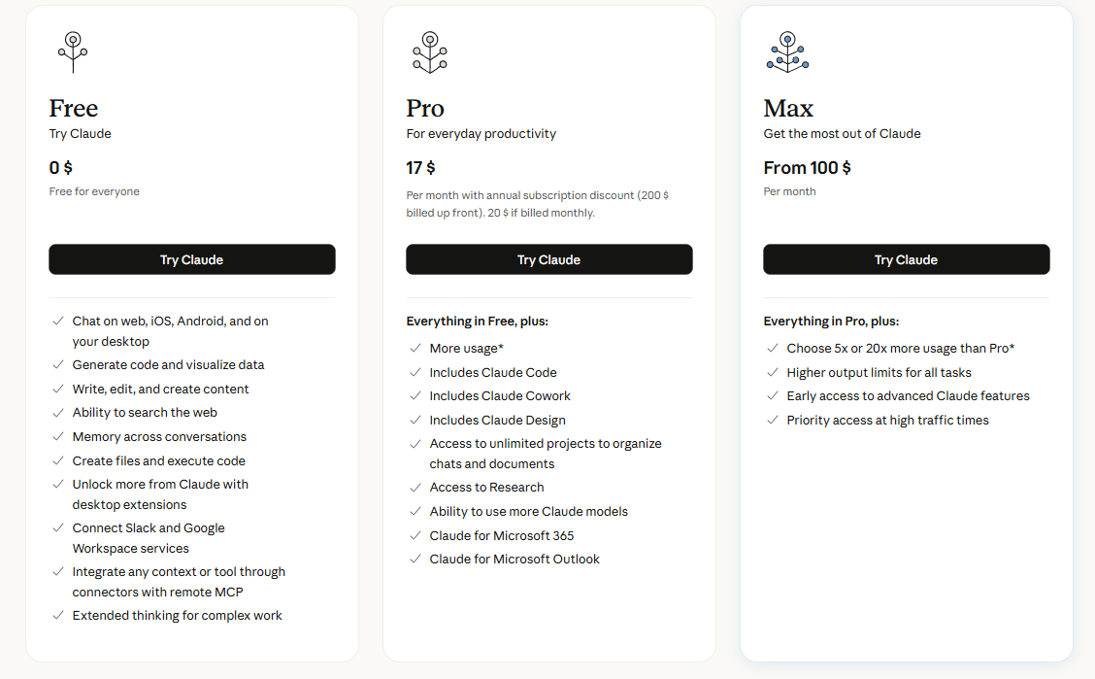
¿Cómo empezar?: Es gratis, pero si quieres usar los modelos de Anthropic, debes pagar al menos USD 17.
Notas: https://claude.com/pricing
Notes:
Model distillation suggests that it’s possible to capture a large model’s behaviors using fewer parameters. Could it be that within the large model, there exists a subset of parameters capable of capturing the entire model’s behavior? This is the core concept behind pruning.
Pruning, in the context of neural networks, has two meanings. One is to remove entire nodes of a neural network, which means changing its architecture and reducing its number of parameters. Another is to find parameters least useful to predictions and set them to zero. In this case, pruning doesn’t reduce the total number of parameters, only the number of non-zero parameters. This makes the model more sparse, which both reduces the model’s storage space and speeds up computation.
Pruned models can be used as-is or be further finetuned to adjust the remaining parameters and restore any performance degradation caused by the pruning process. Pruning can help discover promising model architectures (Liu et al., 2018). These pruned architectures, smaller than the pre-pruned architectures, can also be trained from scratch (Zhu et al., 2017).
In the literature, there have been many encouraging pruning results. For example, Frankle and Carbin (2019) showed that pruning techniques can reduce the non-zero parameter counts of certain trained networks by over 90%, decreasing memory footprints and improving speed without compromising accuracy. However, in practice, as of this writing, pruning is less common. It’s harder to do, as it requires an understanding of the original model’s architecture, and the performance boost it can bring is often much less than that of other approaches. Pruning also results in sparse models, and not all hardware architectures are designed to take advantage of the resulting sparsity.
Weight-only quantization is by far the most popular approach since it’s easy to use, works out of the box for many models, and is extremely effective. Reducing a model’s precision from 32 bits to 16 bits reduces its memory footprint by half. However, we’re close to the limit of quantization—we can’t go lower than 1 bit per value. Distillation is also common because it can result in a smaller model whose behavior is comparative to that of a much larger one for your needs.

Slide 5
¿Cómo empezar?: From 0 To Hero.
1
Instalar Claude Code.
Npm install –g @anthropic-ai/claude-code
2
Iniciar Sesión
claude
3
Abrir en tu proyecto
-cdmiproyecto
4
Primer prompt
Explícame la arquitectura del proyecto.
Notes:
Model distillation suggests that it’s possible to capture a large model’s behaviors using fewer parameters. Could it be that within the large model, there exists a subset of parameters capable of capturing the entire model’s behavior? This is the core concept behind pruning.
Pruning, in the context of neural networks, has two meanings. One is to remove entire nodes of a neural network, which means changing its architecture and reducing its number of parameters. Another is to find parameters least useful to predictions and set them to zero. In this case, pruning doesn’t reduce the total number of parameters, only the number of non-zero parameters. This makes the model more sparse, which both reduces the model’s storage space and speeds up computation.
Pruned models can be used as-is or be further finetuned to adjust the remaining parameters and restore any performance degradation caused by the pruning process. Pruning can help discover promising model architectures (Liu et al., 2018). These pruned architectures, smaller than the pre-pruned architectures, can also be trained from scratch (Zhu et al., 2017).
In the literature, there have been many encouraging pruning results. For example, Frankle and Carbin (2019) showed that pruning techniques can reduce the non-zero parameter counts of certain trained networks by over 90%, decreasing memory footprints and improving speed without compromising accuracy. However, in practice, as of this writing, pruning is less common. It’s harder to do, as it requires an understanding of the original model’s architecture, and the performance boost it can bring is often much less than that of other approaches. Pruning also results in sparse models, and not all hardware architectures are designed to take advantage of the resulting sparsity.
Weight-only quantization is by far the most popular approach since it’s easy to use, works out of the box for many models, and is extremely effective. Reducing a model’s precision from 32 bits to 16 bits reduces its memory footprint by half. However, we’re close to the limit of quantization—we can’t go lower than 1 bit per value. Distillation is also common because it can result in a smaller model whose behavior is comparative to that of a much larger one for your needs.

Slide 6
¿Por qué es útil?: Muchos usos, poco problemas útiles.
Flujo de bugs
Construir Codebase
Testing
1
Instalar Claude Code.
Npm install –g @anthropic-ai/claude-code
Refactoring
2
Iniciar Sesión
claude
3
Abrir en tu proyecto
-cdmiproyecto
Documentación
4
Primer prompt
Explícame la arquitectura del proyecto.
Notes:
Model distillation suggests that it’s possible to capture a large model’s behaviors using fewer parameters. Could it be that within the large model, there exists a subset of parameters capable of capturing the entire model’s behavior? This is the core concept behind pruning.
Pruning, in the context of neural networks, has two meanings. One is to remove entire nodes of a neural network, which means changing its architecture and reducing its number of parameters. Another is to find parameters least useful to predictions and set them to zero. In this case, pruning doesn’t reduce the total number of parameters, only the number of non-zero parameters. This makes the model more sparse, which both reduces the model’s storage space and speeds up computation.
Pruned models can be used as-is or be further finetuned to adjust the remaining parameters and restore any performance degradation caused by the pruning process. Pruning can help discover promising model architectures (Liu et al., 2018). These pruned architectures, smaller than the pre-pruned architectures, can also be trained from scratch (Zhu et al., 2017).
In the literature, there have been many encouraging pruning results. For example, Frankle and Carbin (2019) showed that pruning techniques can reduce the non-zero parameter counts of certain trained networks by over 90%, decreasing memory footprints and improving speed without compromising accuracy. However, in practice, as of this writing, pruning is less common. It’s harder to do, as it requires an understanding of the original model’s architecture, and the performance boost it can bring is often much less than that of other approaches. Pruning also results in sparse models, and not all hardware architectures are designed to take advantage of the resulting sparsity.
Weight-only quantization is by far the most popular approach since it’s easy to use, works out of the box for many models, and is extremely effective. Reducing a model’s precision from 32 bits to 16 bits reduces its memory footprint by half. However, we’re close to the limit of quantization—we can’t go lower than 1 bit per value. Distillation is also common because it can result in a smaller model whose behavior is comparative to that of a much larger one for your needs.

Slide 7
¿Comando?: Trucos fáciles para trabajar con Claude Code.
1
/help
Lista de todos los comando disponibles.
2
/clear
Limpia el historial de conversación
3
/compact
Comprime el contexto para conversaciones largas.
4
/review
Revisa los cambios pendientes del repo
5
/init
Crea Claude.md con docs del proyecto.
6
/memory
Gestiona los archivos de memoria.
7
/doctor
Verifica si el entorno esta bien configurado.
Notes:
Model distillation suggests that it’s possible to capture a large model’s behaviors using fewer parameters. Could it be that within the large model, there exists a subset of parameters capable of capturing the entire model’s behavior? This is the core concept behind pruning.
Pruning, in the context of neural networks, has two meanings. One is to remove entire nodes of a neural network, which means changing its architecture and reducing its number of parameters. Another is to find parameters least useful to predictions and set them to zero. In this case, pruning doesn’t reduce the total number of parameters, only the number of non-zero parameters. This makes the model more sparse, which both reduces the model’s storage space and speeds up computation.
Pruned models can be used as-is or be further finetuned to adjust the remaining parameters and restore any performance degradation caused by the pruning process. Pruning can help discover promising model architectures (Liu et al., 2018). These pruned architectures, smaller than the pre-pruned architectures, can also be trained from scratch (Zhu et al., 2017).
In the literature, there have been many encouraging pruning results. For example, Frankle and Carbin (2019) showed that pruning techniques can reduce the non-zero parameter counts of certain trained networks by over 90%, decreasing memory footprints and improving speed without compromising accuracy. However, in practice, as of this writing, pruning is less common. It’s harder to do, as it requires an understanding of the original model’s architecture, and the performance boost it can bring is often much less than that of other approaches. Pruning also results in sparse models, and not all hardware architectures are designed to take advantage of the resulting sparsity.
Weight-only quantization is by far the most popular approach since it’s easy to use, works out of the box for many models, and is extremely effective. Reducing a model’s precision from 32 bits to 16 bits reduces its memory footprint by half. However, we’re close to the limit of quantization—we can’t go lower than 1 bit per value. Distillation is also common because it can result in a smaller model whose behavior is comparative to that of a much larger one for your needs.

Slide 8
MCP: Model Context Protocol
MCP es un protocolo que permite a Claude conectarse con herramientas y datos externos: bases de datos, APIs, Slack, GitHub y mas.
1
Github MCP
Repos, PRs, Issues, commits.
2
Slack MCP
Mensajes, canales, usuarios
3
PostgresSQL MCP
Queries directo desde Claude.
claude mcp add my-server \
-e API_KEY=xxx \
-- npx server-package
4
FileSystem MCP
Acceso a archivos locales.
5
CopyWriting MCP
Acceso al browers.
Notes:
Model distillation suggests that it’s possible to capture a large model’s behaviors using fewer parameters. Could it be that within the large model, there exists a subset of parameters capable of capturing the entire model’s behavior? This is the core concept behind pruning.
Pruning, in the context of neural networks, has two meanings. One is to remove entire nodes of a neural network, which means changing its architecture and reducing its number of parameters. Another is to find parameters least useful to predictions and set them to zero. In this case, pruning doesn’t reduce the total number of parameters, only the number of non-zero parameters. This makes the model more sparse, which both reduces the model’s storage space and speeds up computation.
Pruned models can be used as-is or be further finetuned to adjust the remaining parameters and restore any performance degradation caused by the pruning process. Pruning can help discover promising model architectures (Liu et al., 2018). These pruned architectures, smaller than the pre-pruned architectures, can also be trained from scratch (Zhu et al., 2017).
In the literature, there have been many encouraging pruning results. For example, Frankle and Carbin (2019) showed that pruning techniques can reduce the non-zero parameter counts of certain trained networks by over 90%, decreasing memory footprints and improving speed without compromising accuracy. However, in practice, as of this writing, pruning is less common. It’s harder to do, as it requires an understanding of the original model’s architecture, and the performance boost it can bring is often much less than that of other approaches. Pruning also results in sparse models, and not all hardware architectures are designed to take advantage of the resulting sparsity.
Weight-only quantization is by far the most popular approach since it’s easy to use, works out of the box for many models, and is extremely effective. Reducing a model’s precision from 32 bits to 16 bits reduces its memory footprint by half. However, we’re close to the limit of quantization—we can’t go lower than 1 bit per value. Distillation is also common because it can result in a smaller model whose behavior is comparative to that of a much larger one for your needs.

Slide 9
Hooks: Automatización con Control
1
PreToolUse
Antes de ejecutar una herramienta.
Los Hooks son scripts que se ejecutan automaticamente antes o despues de acciones de Claude Code. Dan control deterministico sobre el comportamiento del agente.
2
PostToolUse
Despues de ejecutar.
3
Stop
Cuando Claude termina de responder.
4
Notification
Cuando Claude envía una notificación
al usuario.
Notes:
Model distillation suggests that it’s possible to capture a large model’s behaviors using fewer parameters. Could it be that within the large model, there exists a subset of parameters capable of capturing the entire model’s behavior? This is the core concept behind pruning.
Pruning, in the context of neural networks, has two meanings. One is to remove entire nodes of a neural network, which means changing its architecture and reducing its number of parameters. Another is to find parameters least useful to predictions and set them to zero. In this case, pruning doesn’t reduce the total number of parameters, only the number of non-zero parameters. This makes the model more sparse, which both reduces the model’s storage space and speeds up computation.
Pruned models can be used as-is or be further finetuned to adjust the remaining parameters and restore any performance degradation caused by the pruning process. Pruning can help discover promising model architectures (Liu et al., 2018). These pruned architectures, smaller than the pre-pruned architectures, can also be trained from scratch (Zhu et al., 2017).
In the literature, there have been many encouraging pruning results. For example, Frankle and Carbin (2019) showed that pruning techniques can reduce the non-zero parameter counts of certain trained networks by over 90%, decreasing memory footprints and improving speed without compromising accuracy. However, in practice, as of this writing, pruning is less common. It’s harder to do, as it requires an understanding of the original model’s architecture, and the performance boost it can bring is often much less than that of other approaches. Pruning also results in sparse models, and not all hardware architectures are designed to take advantage of the resulting sparsity.
Weight-only quantization is by far the most popular approach since it’s easy to use, works out of the box for many models, and is extremely effective. Reducing a model’s precision from 32 bits to 16 bits reduces its memory footprint by half. However, we’re close to the limit of quantization—we can’t go lower than 1 bit per value. Distillation is also common because it can result in a smaller model whose behavior is comparative to that of a much larger one for your needs.

Slide 10
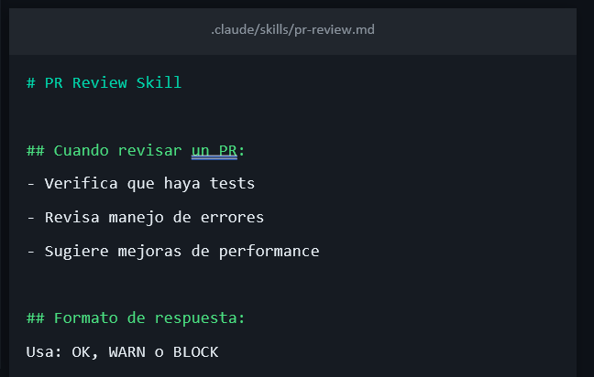
Skills: Instrucciones Reutilizables.
¿Como funciona?
Un Skill es un archivo Markdown con instrucciones que Claude aplica automaticamente cuando la tarea coincide. Define las instrucciones una vez, Claude las reutiliza siempre.
1
Creas un archivo SKILL.md con instrucciones
2
Lo guardas en .claude/skills/
3
Claude lo detecta y aplica automaticamente
4
Puedes compartirlo con tu equipo via git
Notes:
Model distillation suggests that it’s possible to capture a large model’s behaviors using fewer parameters. Could it be that within the large model, there exists a subset of parameters capable of capturing the entire model’s behavior? This is the core concept behind pruning.
Pruning, in the context of neural networks, has two meanings. One is to remove entire nodes of a neural network, which means changing its architecture and reducing its number of parameters. Another is to find parameters least useful to predictions and set them to zero. In this case, pruning doesn’t reduce the total number of parameters, only the number of non-zero parameters. This makes the model more sparse, which both reduces the model’s storage space and speeds up computation.
Pruned models can be used as-is or be further finetuned to adjust the remaining parameters and restore any performance degradation caused by the pruning process. Pruning can help discover promising model architectures (Liu et al., 2018). These pruned architectures, smaller than the pre-pruned architectures, can also be trained from scratch (Zhu et al., 2017).
In the literature, there have been many encouraging pruning results. For example, Frankle and Carbin (2019) showed that pruning techniques can reduce the non-zero parameter counts of certain trained networks by over 90%, decreasing memory footprints and improving speed without compromising accuracy. However, in practice, as of this writing, pruning is less common. It’s harder to do, as it requires an understanding of the original model’s architecture, and the performance boost it can bring is often much less than that of other approaches. Pruning also results in sparse models, and not all hardware architectures are designed to take advantage of the resulting sparsity.
Weight-only quantization is by far the most popular approach since it’s easy to use, works out of the box for many models, and is extremely effective. Reducing a model’s precision from 32 bits to 16 bits reduces its memory footprint by half. However, we’re close to the limit of quantization—we can’t go lower than 1 bit per value. Distillation is also common because it can result in a smaller model whose behavior is comparative to that of a much larger one for your needs.

Slide 11
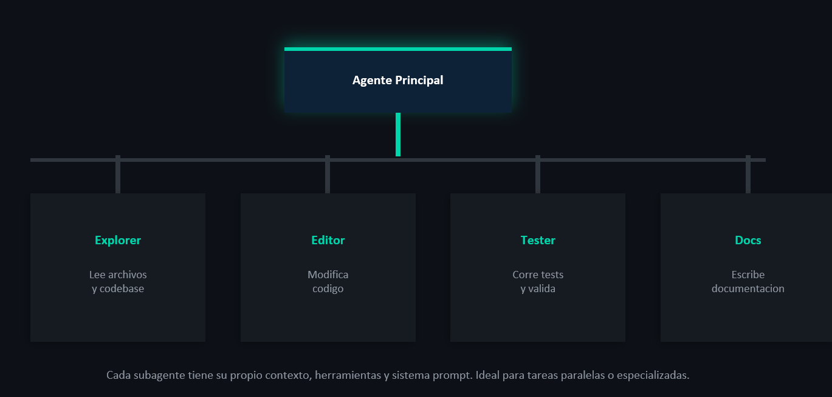
Agentes: Divide y Vencerás.
¿Como funciona?
Un Skill es un archivo Markdown con instrucciones que Claude aplica automaticamente cuando la tarea coincide. Define las instrucciones una vez, Claude las reutiliza siempre.
1
Creas un archivo SKILL.md con instrucciones
2
Lo guardas en .claude/skills/
3
Claude lo detecta y aplica automaticamente
4
Puedes compartirlo con tu equipo via git
Notes:
Model distillation suggests that it’s possible to capture a large model’s behaviors using fewer parameters. Could it be that within the large model, there exists a subset of parameters capable of capturing the entire model’s behavior? This is the core concept behind pruning.
Pruning, in the context of neural networks, has two meanings. One is to remove entire nodes of a neural network, which means changing its architecture and reducing its number of parameters. Another is to find parameters least useful to predictions and set them to zero. In this case, pruning doesn’t reduce the total number of parameters, only the number of non-zero parameters. This makes the model more sparse, which both reduces the model’s storage space and speeds up computation.
Pruned models can be used as-is or be further finetuned to adjust the remaining parameters and restore any performance degradation caused by the pruning process. Pruning can help discover promising model architectures (Liu et al., 2018). These pruned architectures, smaller than the pre-pruned architectures, can also be trained from scratch (Zhu et al., 2017).
In the literature, there have been many encouraging pruning results. For example, Frankle and Carbin (2019) showed that pruning techniques can reduce the non-zero parameter counts of certain trained networks by over 90%, decreasing memory footprints and improving speed without compromising accuracy. However, in practice, as of this writing, pruning is less common. It’s harder to do, as it requires an understanding of the original model’s architecture, and the performance boost it can bring is often much less than that of other approaches. Pruning also results in sparse models, and not all hardware architectures are designed to take advantage of the resulting sparsity.
Weight-only quantization is by far the most popular approach since it’s easy to use, works out of the box for many models, and is extremely effective. Reducing a model’s precision from 32 bits to 16 bits reduces its memory footprint by half. However, we’re close to the limit of quantization—we can’t go lower than 1 bit per value. Distillation is also common because it can result in a smaller model whose behavior is comparative to that of a much larger one for your needs.

Slide 12


¿A quien escuchar?: Daniel Ávila.
https://aitmpl.com/
¿Como funciona?
Un Skill es un archivo Markdown con instrucciones que Claude aplica automaticamente cuando la tarea coincide. Define las instrucciones una vez, Claude las reutiliza siempre.
1
https://aitmpl.com/
2
https://aitmpl.com/
3
Claude lo detecta y aplica automaticamente
4
Puedes compartirlo con tu equipo via git
Notes:
Model distillation suggests that it’s possible to capture a large model’s behaviors using fewer parameters. Could it be that within the large model, there exists a subset of parameters capable of capturing the entire model’s behavior? This is the core concept behind pruning.
Pruning, in the context of neural networks, has two meanings. One is to remove entire nodes of a neural network, which means changing its architecture and reducing its number of parameters. Another is to find parameters least useful to predictions and set them to zero. In this case, pruning doesn’t reduce the total number of parameters, only the number of non-zero parameters. This makes the model more sparse, which both reduces the model’s storage space and speeds up computation.
Pruned models can be used as-is or be further finetuned to adjust the remaining parameters and restore any performance degradation caused by the pruning process. Pruning can help discover promising model architectures (Liu et al., 2018). These pruned architectures, smaller than the pre-pruned architectures, can also be trained from scratch (Zhu et al., 2017).
In the literature, there have been many encouraging pruning results. For example, Frankle and Carbin (2019) showed that pruning techniques can reduce the non-zero parameter counts of certain trained networks by over 90%, decreasing memory footprints and improving speed without compromising accuracy. However, in practice, as of this writing, pruning is less common. It’s harder to do, as it requires an understanding of the original model’s architecture, and the performance boost it can bring is often much less than that of other approaches. Pruning also results in sparse models, and not all hardware architectures are designed to take advantage of the resulting sparsity.
Weight-only quantization is by far the most popular approach since it’s easy to use, works out of the box for many models, and is extremely effective. Reducing a model’s precision from 32 bits to 16 bits reduces its memory footprint by half. However, we’re close to the limit of quantization—we can’t go lower than 1 bit per value. Distillation is also common because it can result in a smaller model whose behavior is comparative to that of a much larger one for your needs.

Slide 13
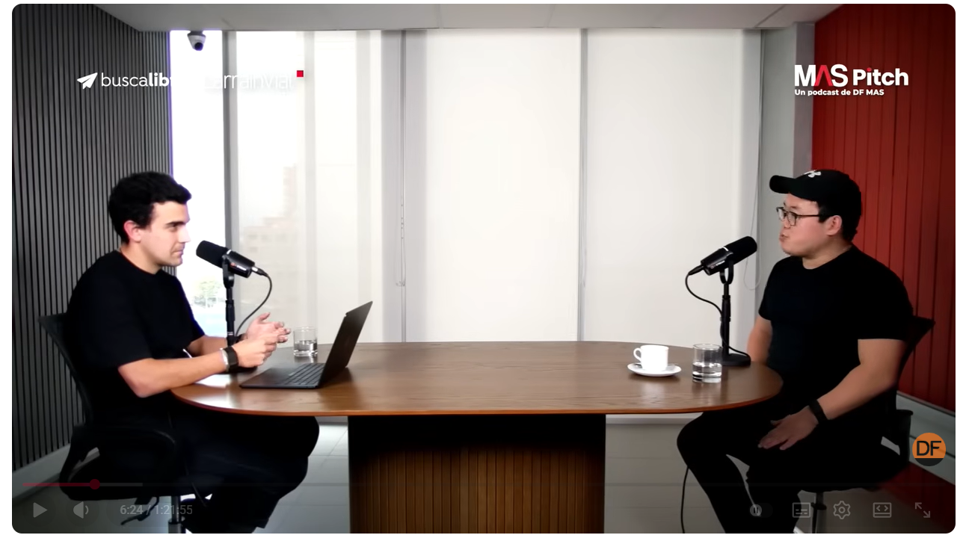
¿A quien escuchar?: Ian Lee, fundador de Nexor.
1
https://aitmpl.com/
2
https://aitmpl.com/
https://www.youtube.com/watch?v=JXn8lYzU_eg
Notes:
Model distillation suggests that it’s possible to capture a large model’s behaviors using fewer parameters. Could it be that within the large model, there exists a subset of parameters capable of capturing the entire model’s behavior? This is the core concept behind pruning.
Pruning, in the context of neural networks, has two meanings. One is to remove entire nodes of a neural network, which means changing its architecture and reducing its number of parameters. Another is to find parameters least useful to predictions and set them to zero. In this case, pruning doesn’t reduce the total number of parameters, only the number of non-zero parameters. This makes the model more sparse, which both reduces the model’s storage space and speeds up computation.
Pruned models can be used as-is or be further finetuned to adjust the remaining parameters and restore any performance degradation caused by the pruning process. Pruning can help discover promising model architectures (Liu et al., 2018). These pruned architectures, smaller than the pre-pruned architectures, can also be trained from scratch (Zhu et al., 2017).
In the literature, there have been many encouraging pruning results. For example, Frankle and Carbin (2019) showed that pruning techniques can reduce the non-zero parameter counts of certain trained networks by over 90%, decreasing memory footprints and improving speed without compromising accuracy. However, in practice, as of this writing, pruning is less common. It’s harder to do, as it requires an understanding of the original model’s architecture, and the performance boost it can bring is often much less than that of other approaches. Pruning also results in sparse models, and not all hardware architectures are designed to take advantage of the resulting sparsity.
Weight-only quantization is by far the most popular approach since it’s easy to use, works out of the box for many models, and is extremely effective. Reducing a model’s precision from 32 bits to 16 bits reduces its memory footprint by half. However, we’re close to the limit of quantization—we can’t go lower than 1 bit per value. Distillation is also common because it can result in a smaller model whose behavior is comparative to that of a much larger one for your needs.

